Slide 1
President’s Welcome

Slide 2
Presentation of the
Class of 2023
Fellows

Slide 3
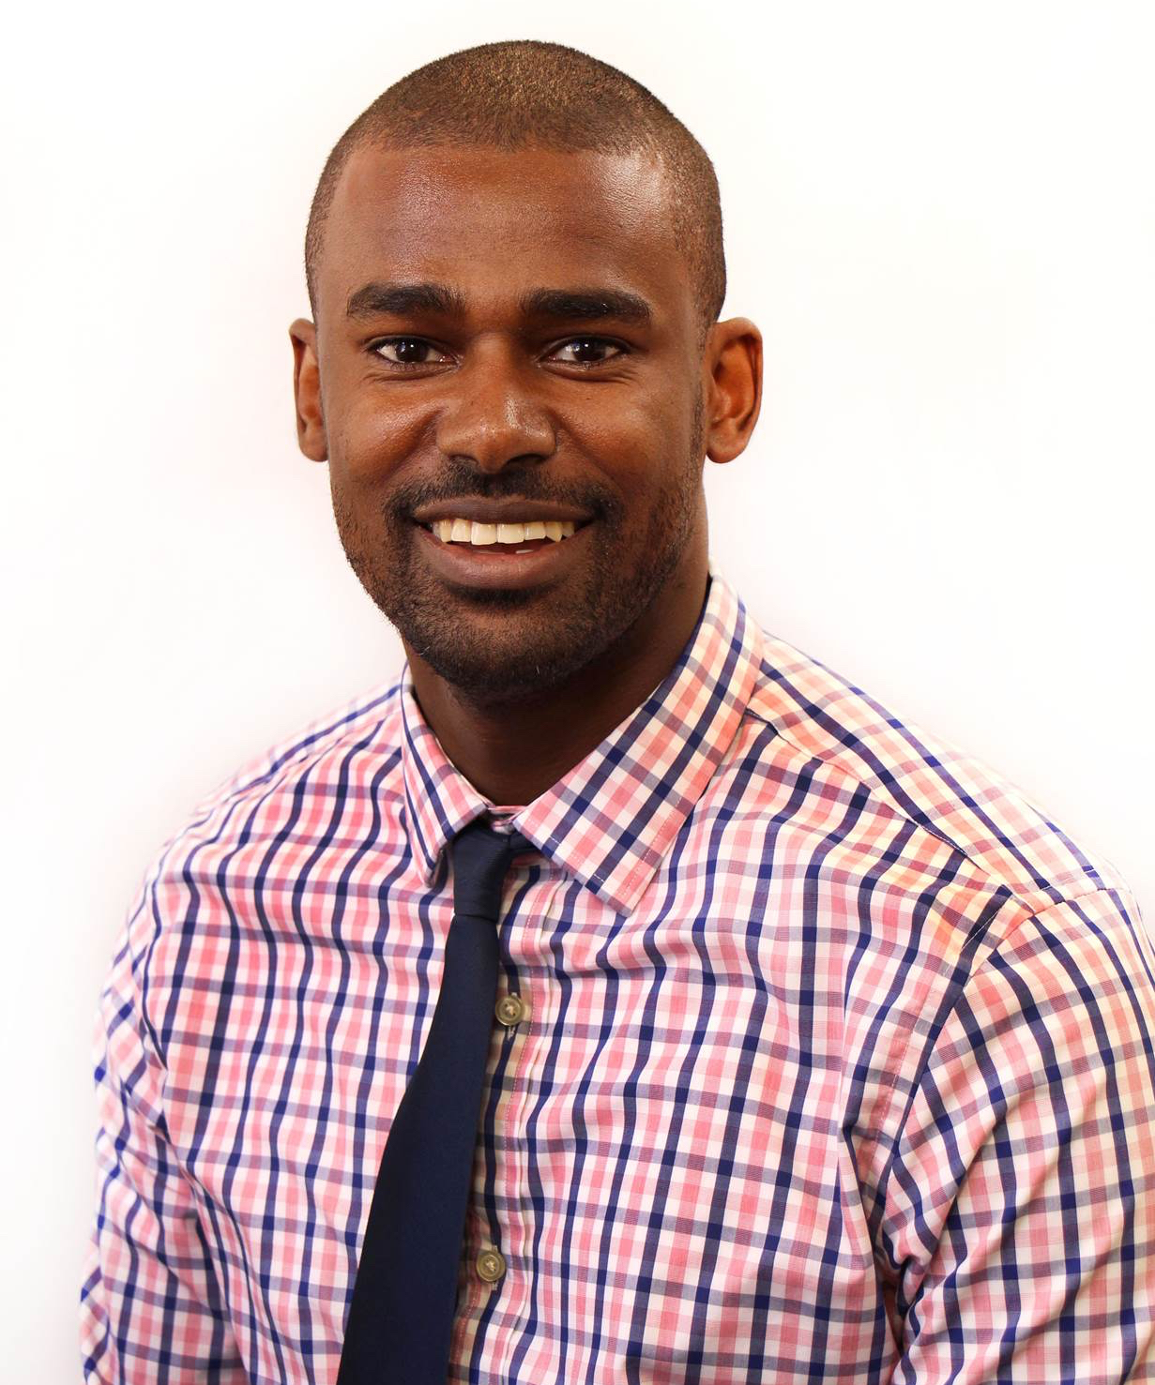
Class of 2023 Fellows
Kaleab Abebe, PhD

Slide 4
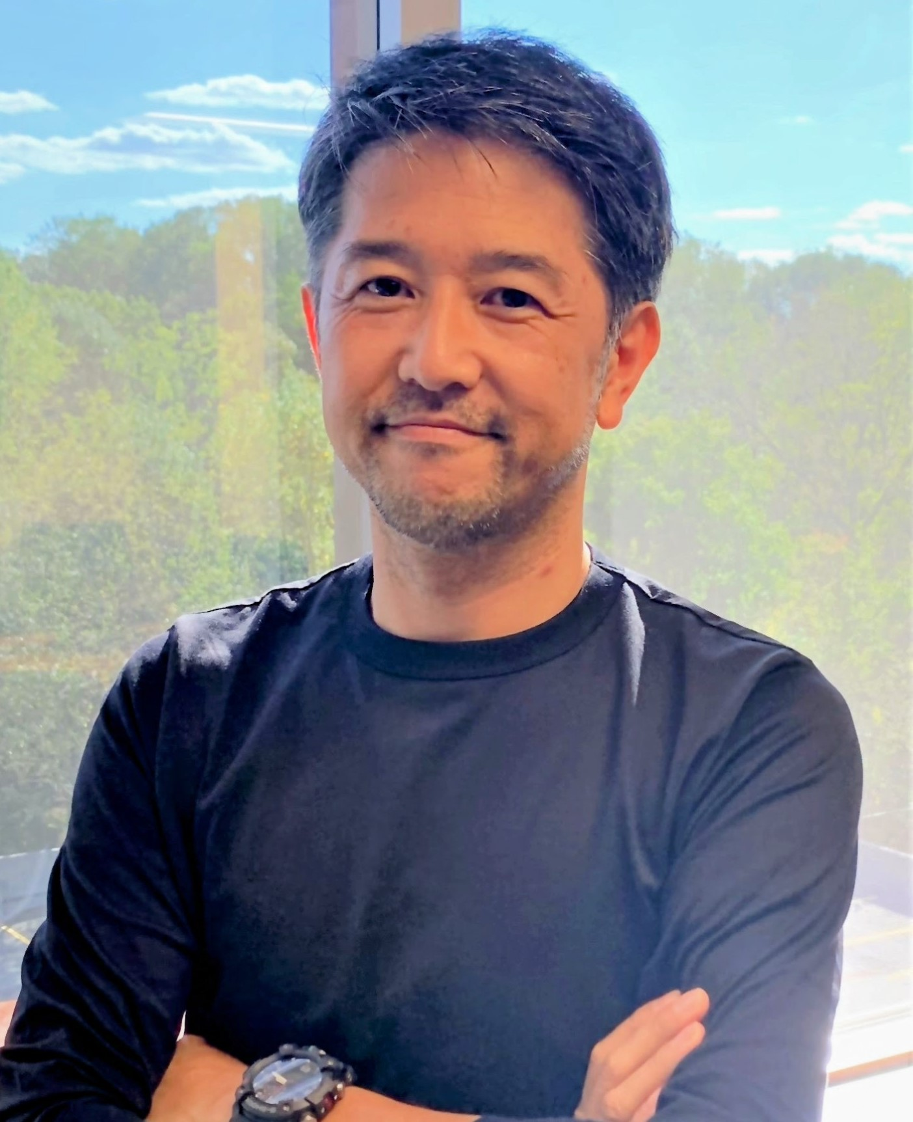
Class of 2023 Fellows
Toshimitsu Hamasaki, PhD

Slide 5
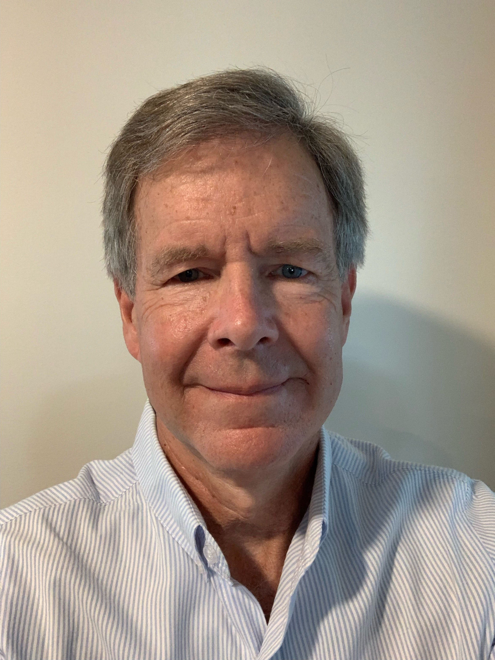
Class of 2023 Fellows
Robert Lindblad, MD

Slide 6
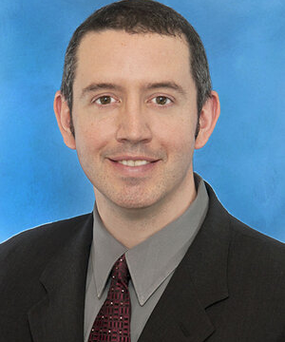
Class of 2023 Fellows
William Meurer, MD

